Slide 1
VIRTUAL MOUSE USING EYE GESTURES
Tech bots – CSE-AIML – 2nd year
Sneha Kamathamu-22J41a66J0
n.Tejaswini-22j41a66G8
K.niharika-22j41a66e5
v.Pranitha-22j41a66j6
r.suchitha-22j41a66h2
M.Venkat-22j41a66g1

Slide 2
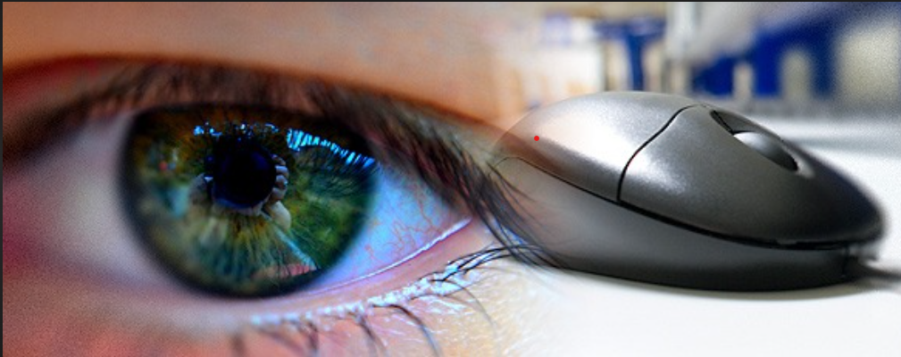
Eye mouse…
What is Eye Mouse…??
Eye mouse is a real time gaze determination software that controls a computer cursor by following the user’s gaze.

Slide 3
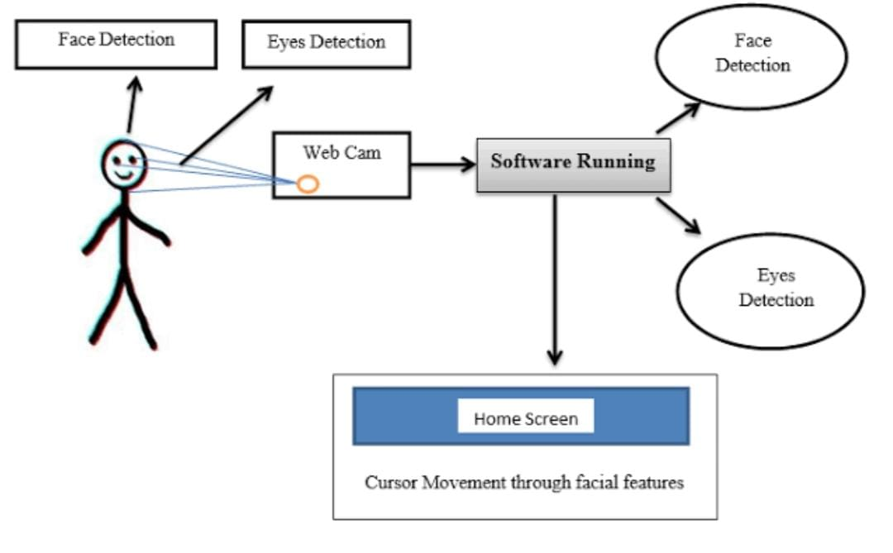
Working of virtual eye mouse

Slide 4
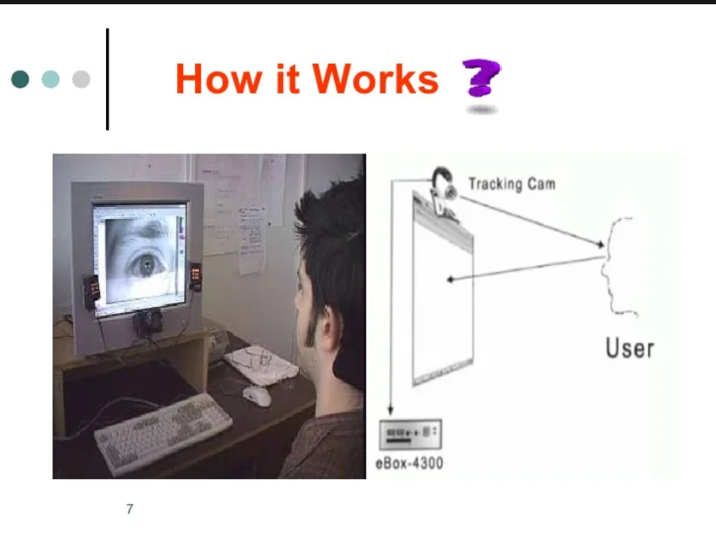

Slide 5
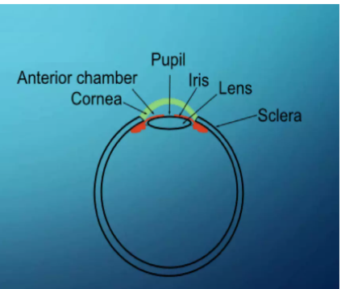
EYE TRACKING:
THE HUMAN EYE
Anterior Chamber
Lens
Iris with the central opening (pupil)
Transparent Cornea
Sclera

Slide 6
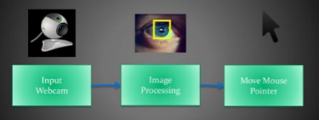
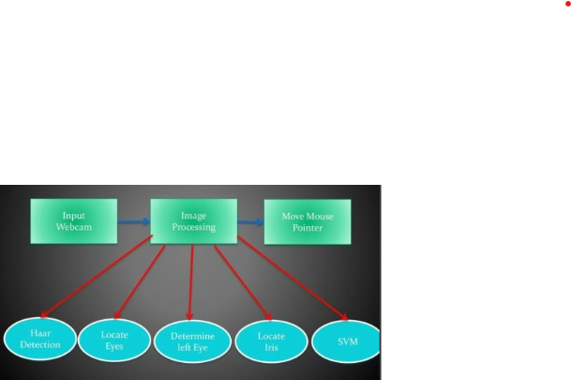
Features of Virtual mouse using eye gestures :
Simple and easy to use
Simple requirements
No additional hardware
Faster capture of frames
GUI Settings
Multipurpose

Slide 7
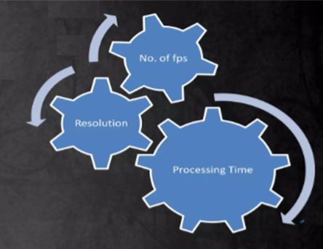
PROS:
Cons:
Easier computer control.
Help disabled & handicapped
people to use computer.
It is simple, multipurpose and
helpful in virtual or interactive
computer gaming and
advertisement.
Eye mouse is a very helpful tool
which can replace a normal
mouse device.
Real time limitations.
Performance dependency:
-- No. of frames captured per second.
-- Camera resolution.
Resolution and fps tradeoffs.

Slide 8
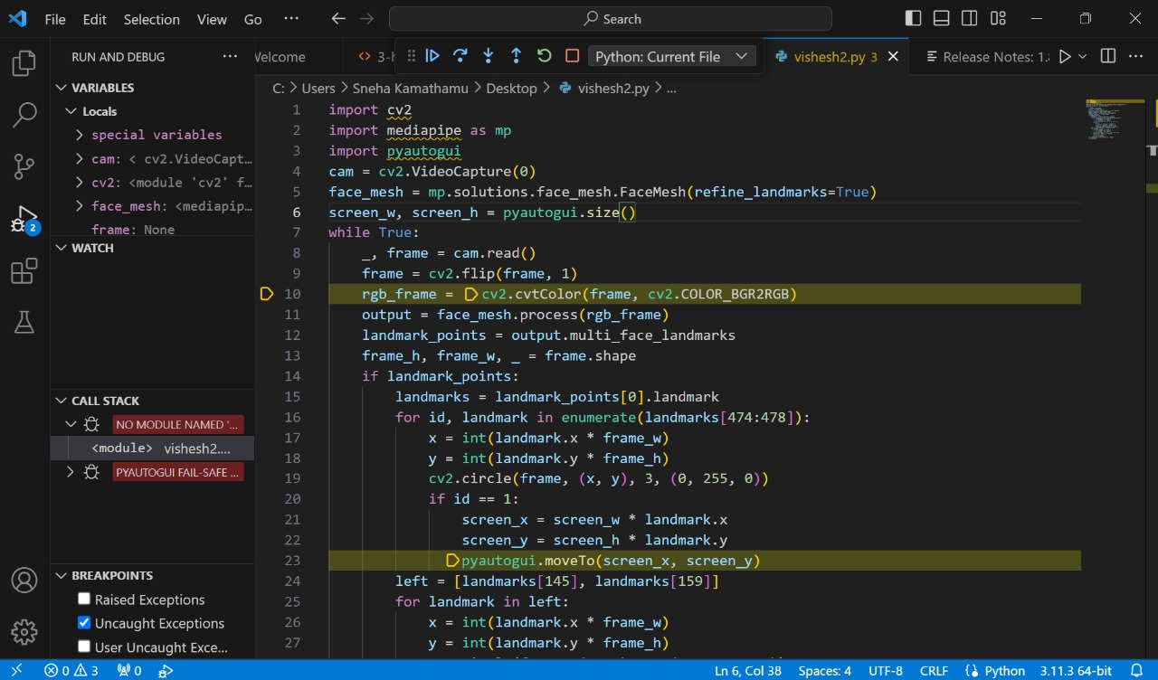

Slide 9
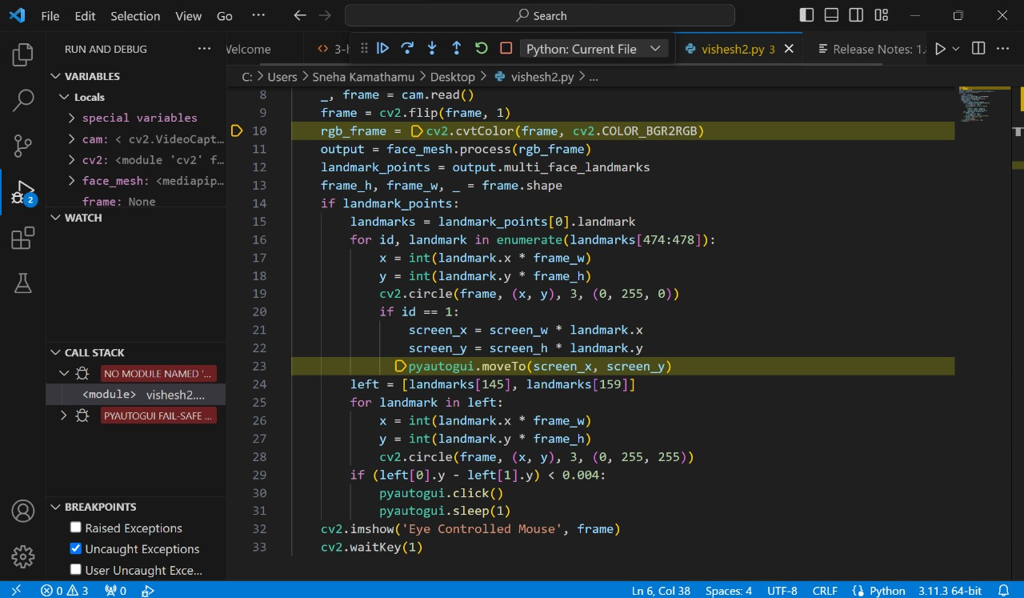

Slide 10
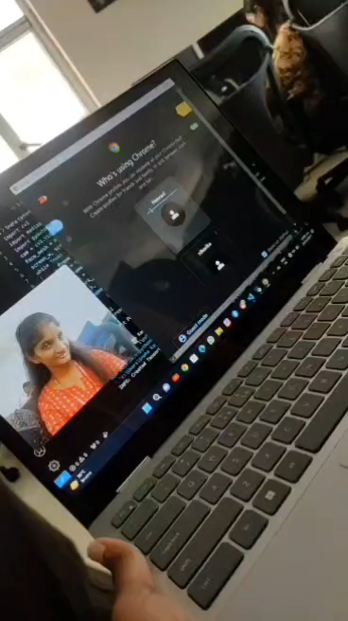

Slide 11
Thank You

